Slide 1
Mars Lander Assignment IA Summer
Mary Liu
yl920

Slide 2
Assignment 1
Write a program to execute the Euler and Verlet algorithms for the mass on the spring, and plot the trajectories of the dynamical variables as functions of time. Convince yourself that the programs work by solving the equation of motion analytically. To get you started, a Python script for the Euler method is provided on the Moodle course page.
Investigate the numerical solution for various different values of the time step ∆t. Compare the performance of the two algorithms over several thousand oscillations, both with each other and also with the exact analytical solution. For example, if you take m = k = v0 = 1 and calculate the trajectory from t = 0 to t = 1000, you should find that the Verlet integrator is stable for ∆t = 1 but not for ∆t = 2.
Find, by trial and error, the critical value of ∆t for the Verlet case, above which it becomes unstable. The first order Euler integrator is never completely stable, but gets better for smaller values of ∆t.

Slide 3
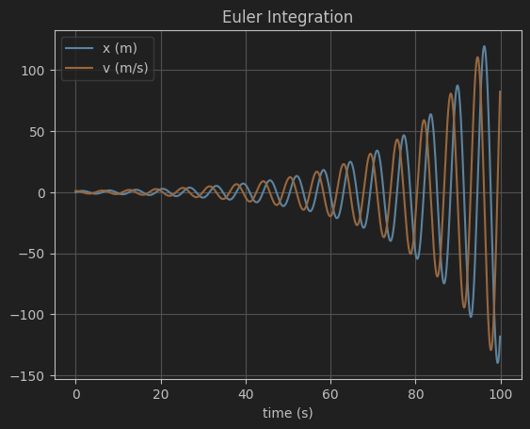
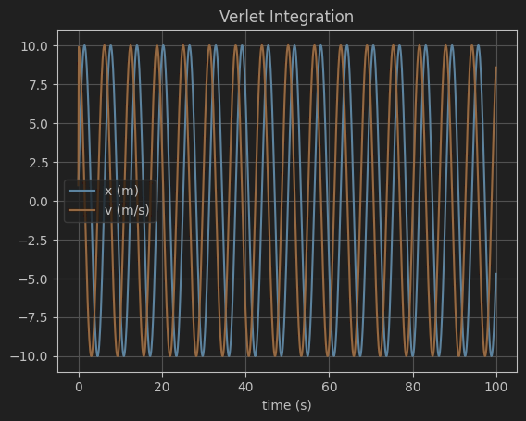
1.1
Both t_max=100, dt=0.1

Slide 4
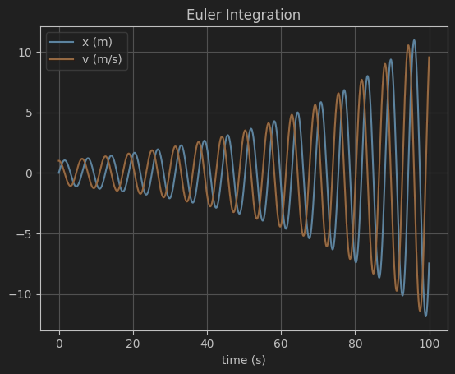
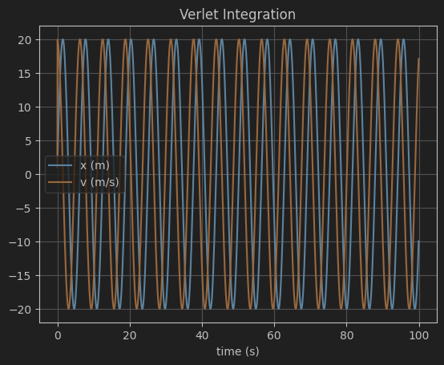
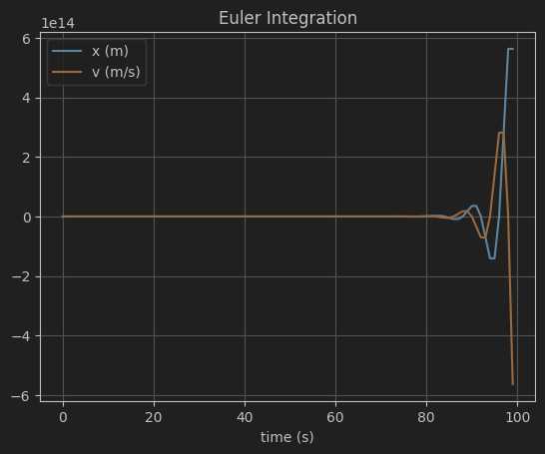
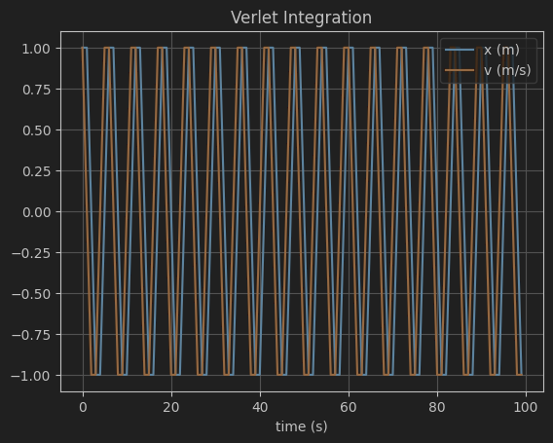
1.2
T_max=100, dt=0.05
dt = 1

Slide 5
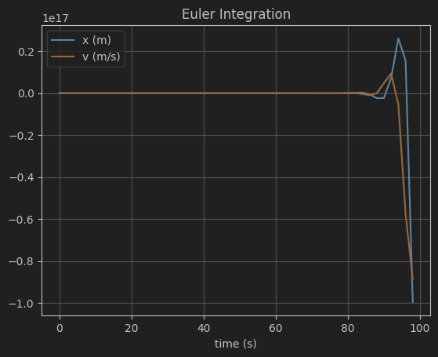
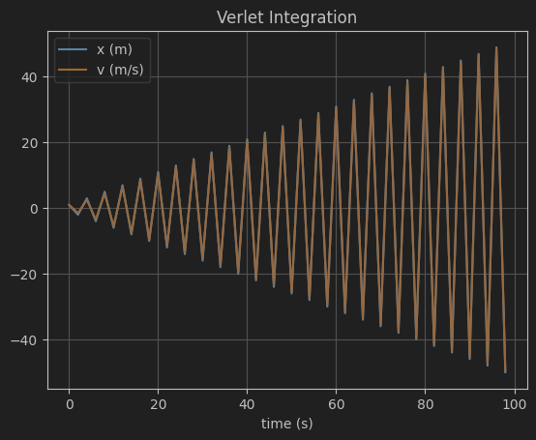
Dt = 2

Slide 6
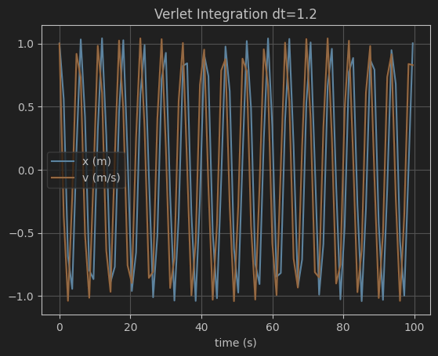
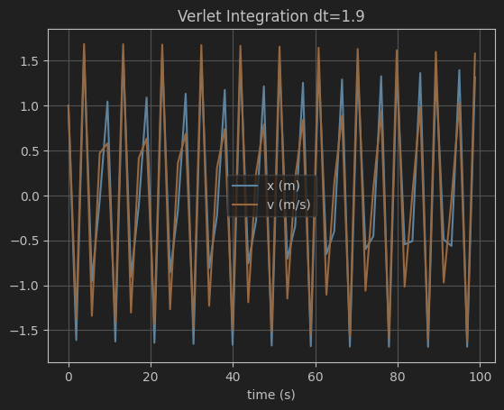
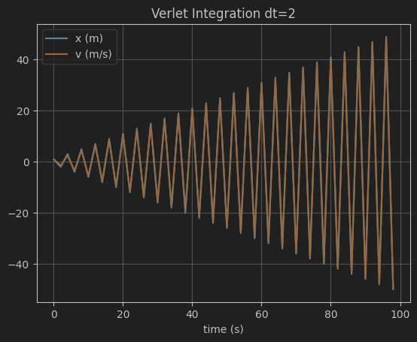
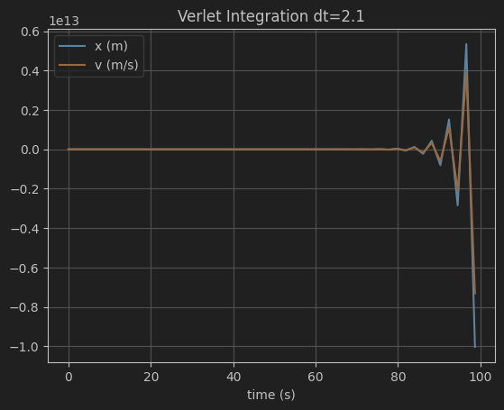
1.3
Critical value of dt=2

Slide 7
Assignment 2
After modifying your Euler and Verlet programs as described above, check them by simulating: 1. Straight down descent 3. Elliptical orbit 2. Circular orbit 4. Hyperbolic escape For simplicity, take the centre of the planet to be the origin of the coordinate system, and the direction of the initial velocity to be perpendicular to the initial position vector of the body for Scenarios 2–4. Use zero initial velocity for Scenario 1. You will obtain different orbits by adjusting the magnitude of the initial velocity. It might help if you first calculate the required speed for a circular orbit, and the escape velocity (use the principle of conservation of energy). For Scenario 1, plot altitude as a function of time. For Scenarios 2–4, plot the trajectory in the orbital plane.

Slide 8
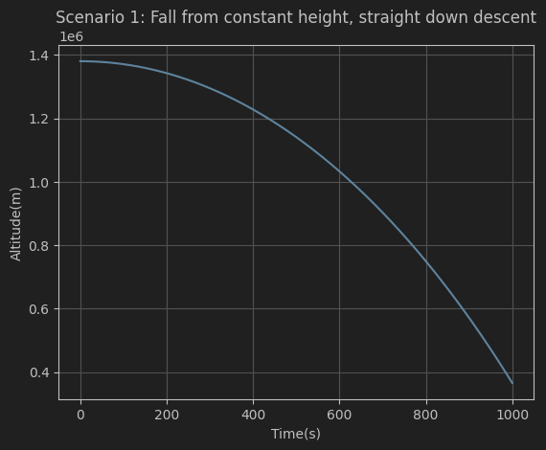
Scenario 1:

Slide 9
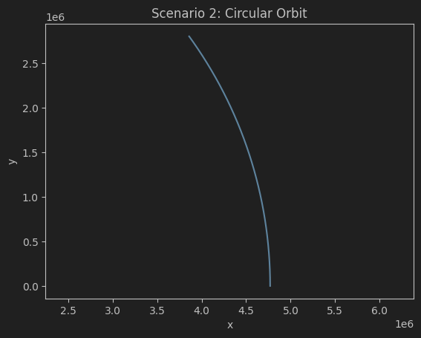
Trajectory for Scenario 2:

Slide 10
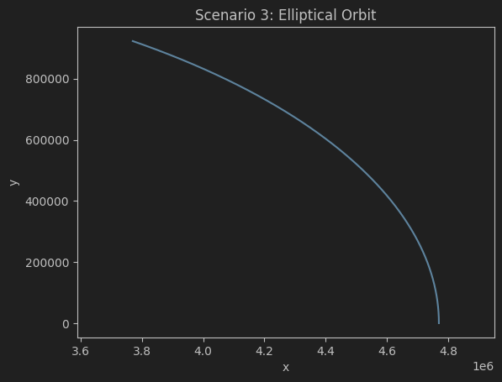
Trajectory for Scenario 3:

Slide 11
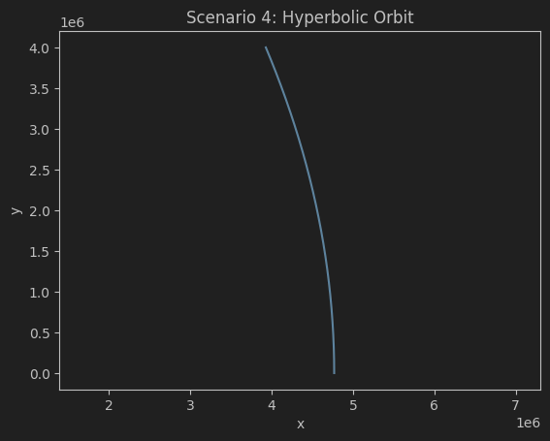
Trajectory for Scenario 4:

Slide 12
Assignment 3: familiarisation with C++
Read through Appendix A for a quick introduction to C++. This includes a worked C++ example of an Euler simulation of a mass on a spring, which you can compare and contrast with the Python equivalent in Assignment 1.
Measure the execution time of the Python and C++ simulations, both with and without C++ compiler optimizations. Modify the provided C++ code to perform Verlet instead of Euler integration.

Slide 13
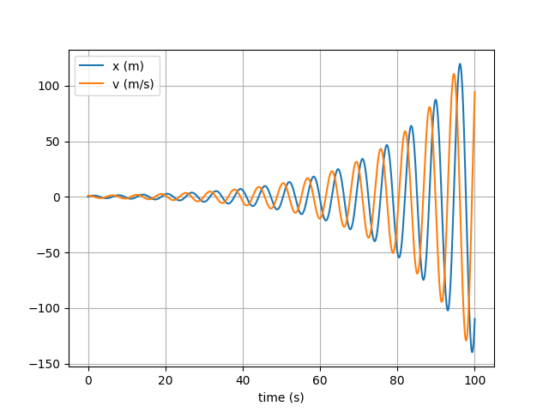
Cpp Euler integration
Python execution time: 0.38007593154907227 s
Cpp execution time: 0.531 s

Slide 14
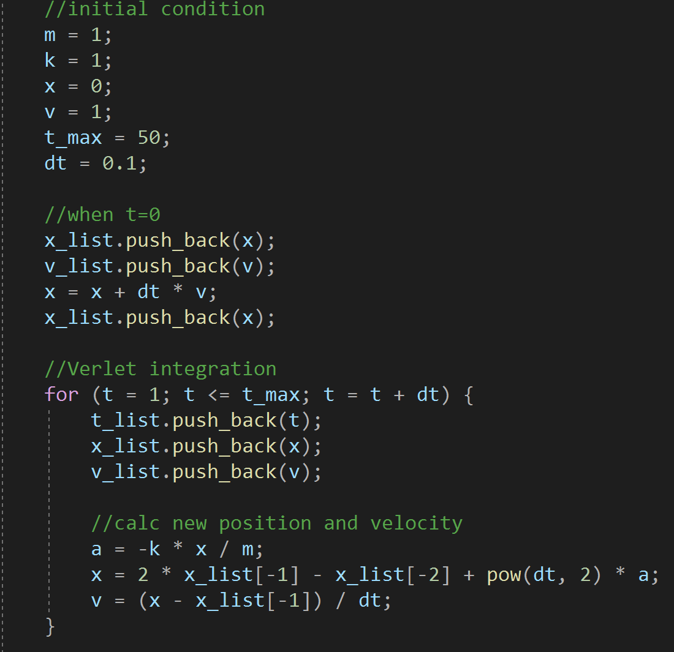
Verlet integration C++ code:

Slide 15
Assignment 4: Landing craft simulation
Considering the extra thrust and drag forces, update the lander’s positions and velocity in lander.cpp using both Euler and Verlet integrator.
A correct Verlet-based simulator should:
• Crash the lander after 83.5 s with a final descent rate of 176.1 ms−1 in Scenario 1.
• Crash the lander after 42629.6 s with a final descent rate of 172.0 ms−1 in Scenario 4.
• Crash the lander after 361.7 s with a final descent rate of 328.7 ms−1 in Scenario 5.
Use the simulator to land the craft on the surface without breaking it.
Finally, compare the performance of the Euler and Verlet integrators.

Slide 16
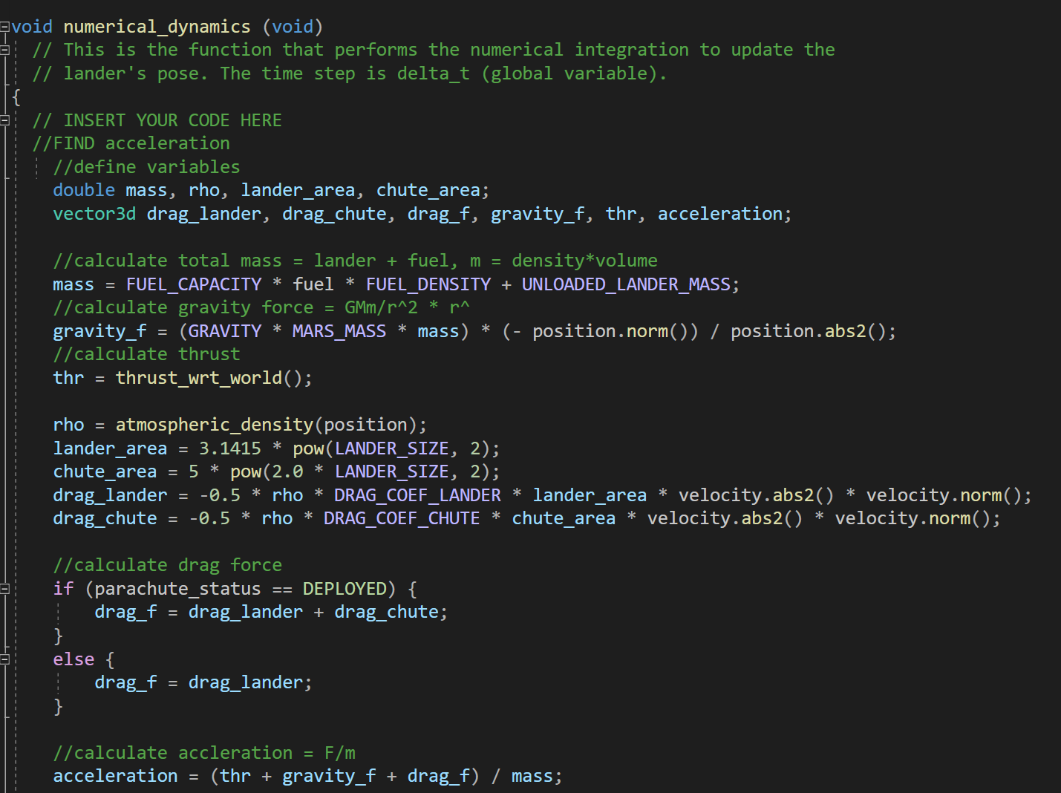
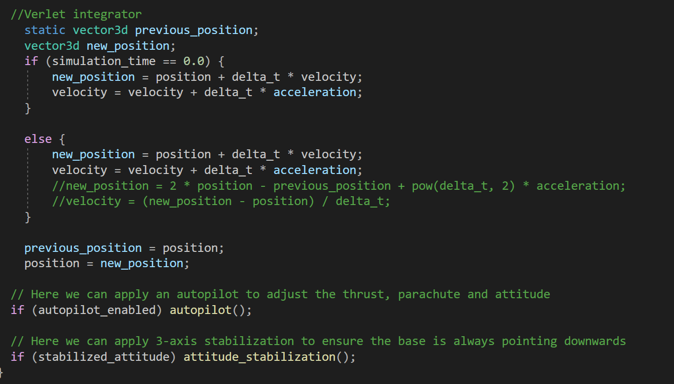
Code of numerical integration

Slide 17
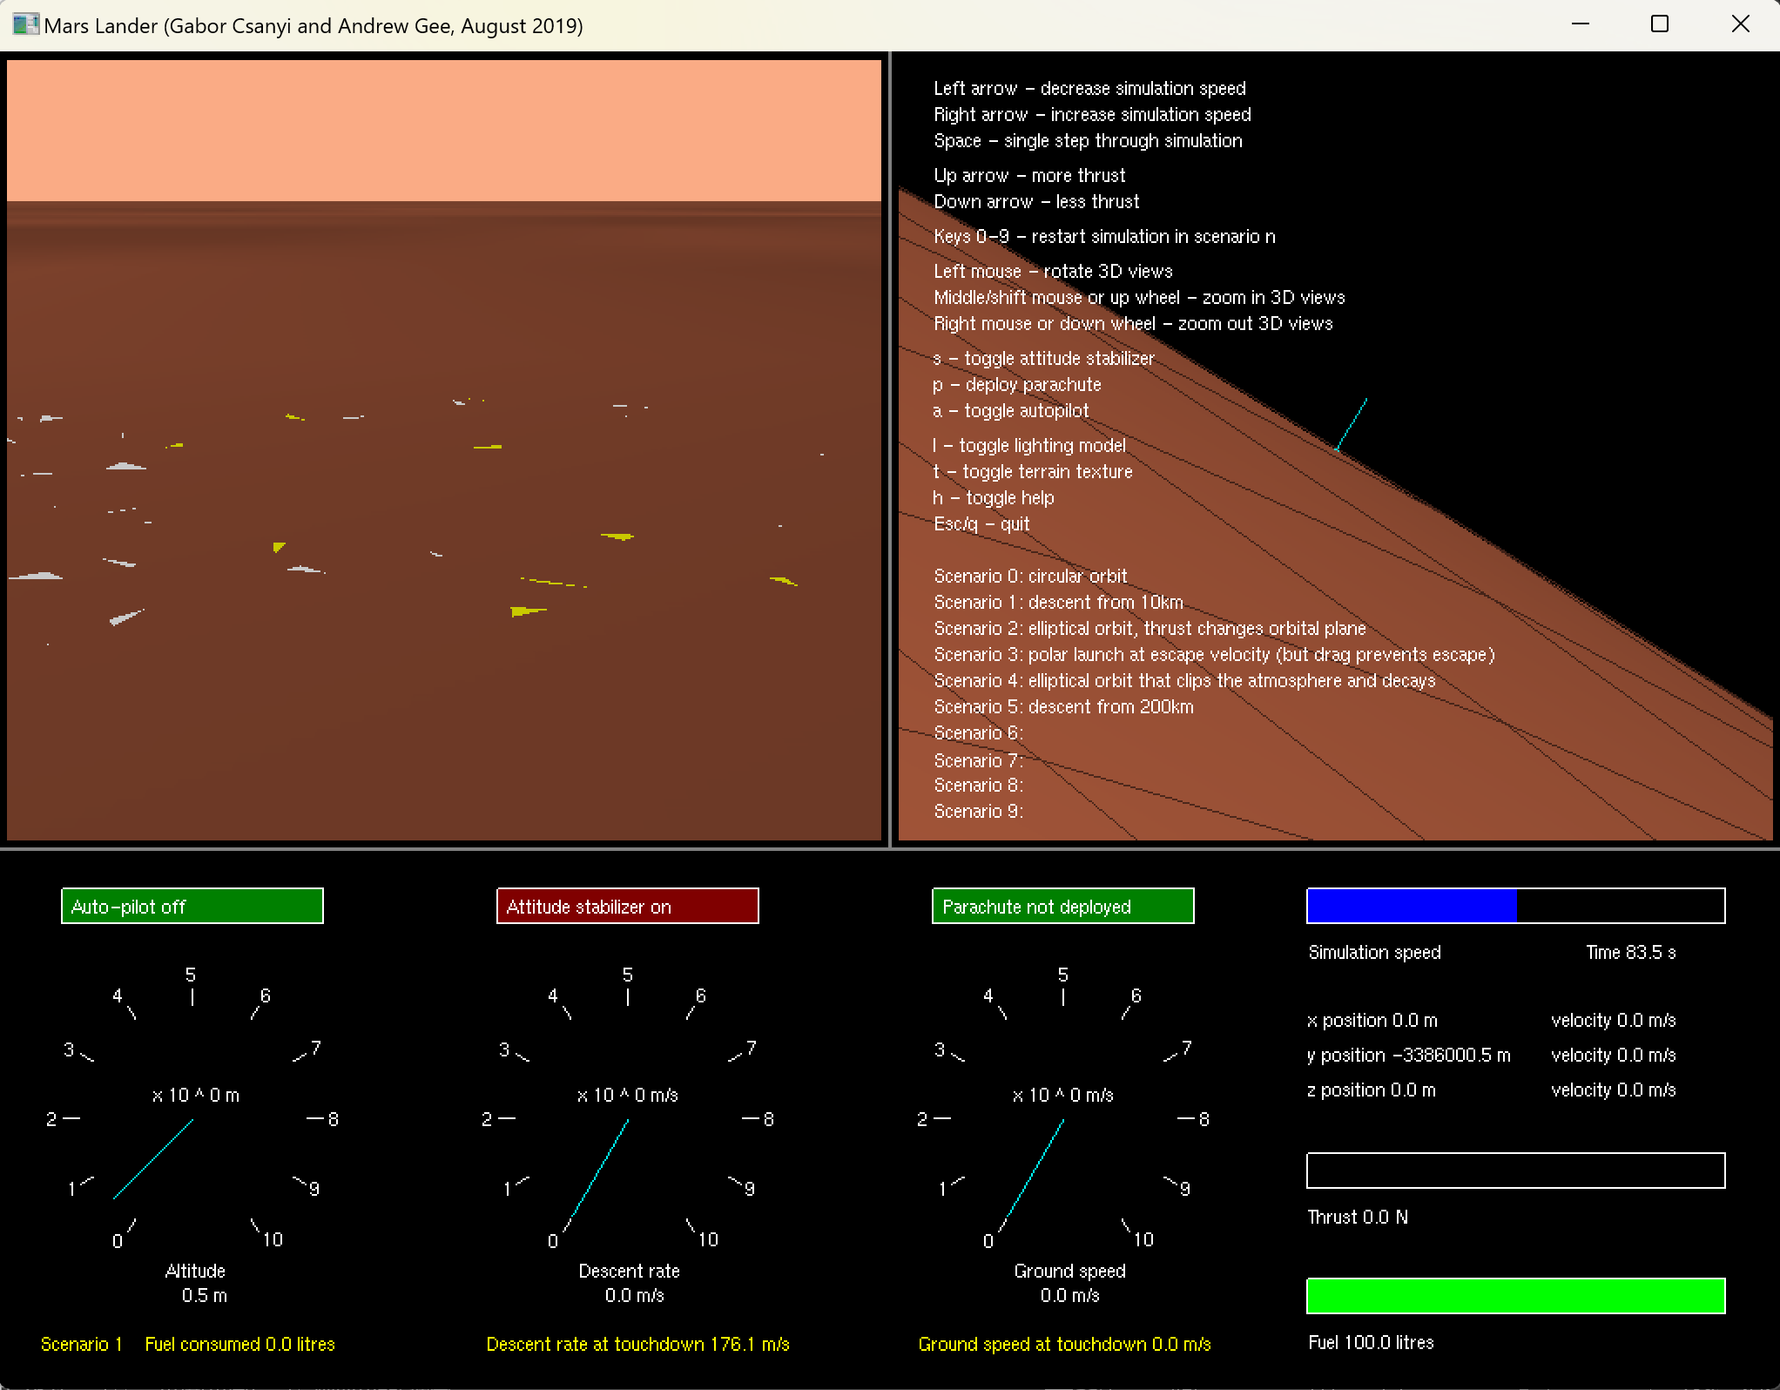
Scenario 1 fits the results given.

Slide 18
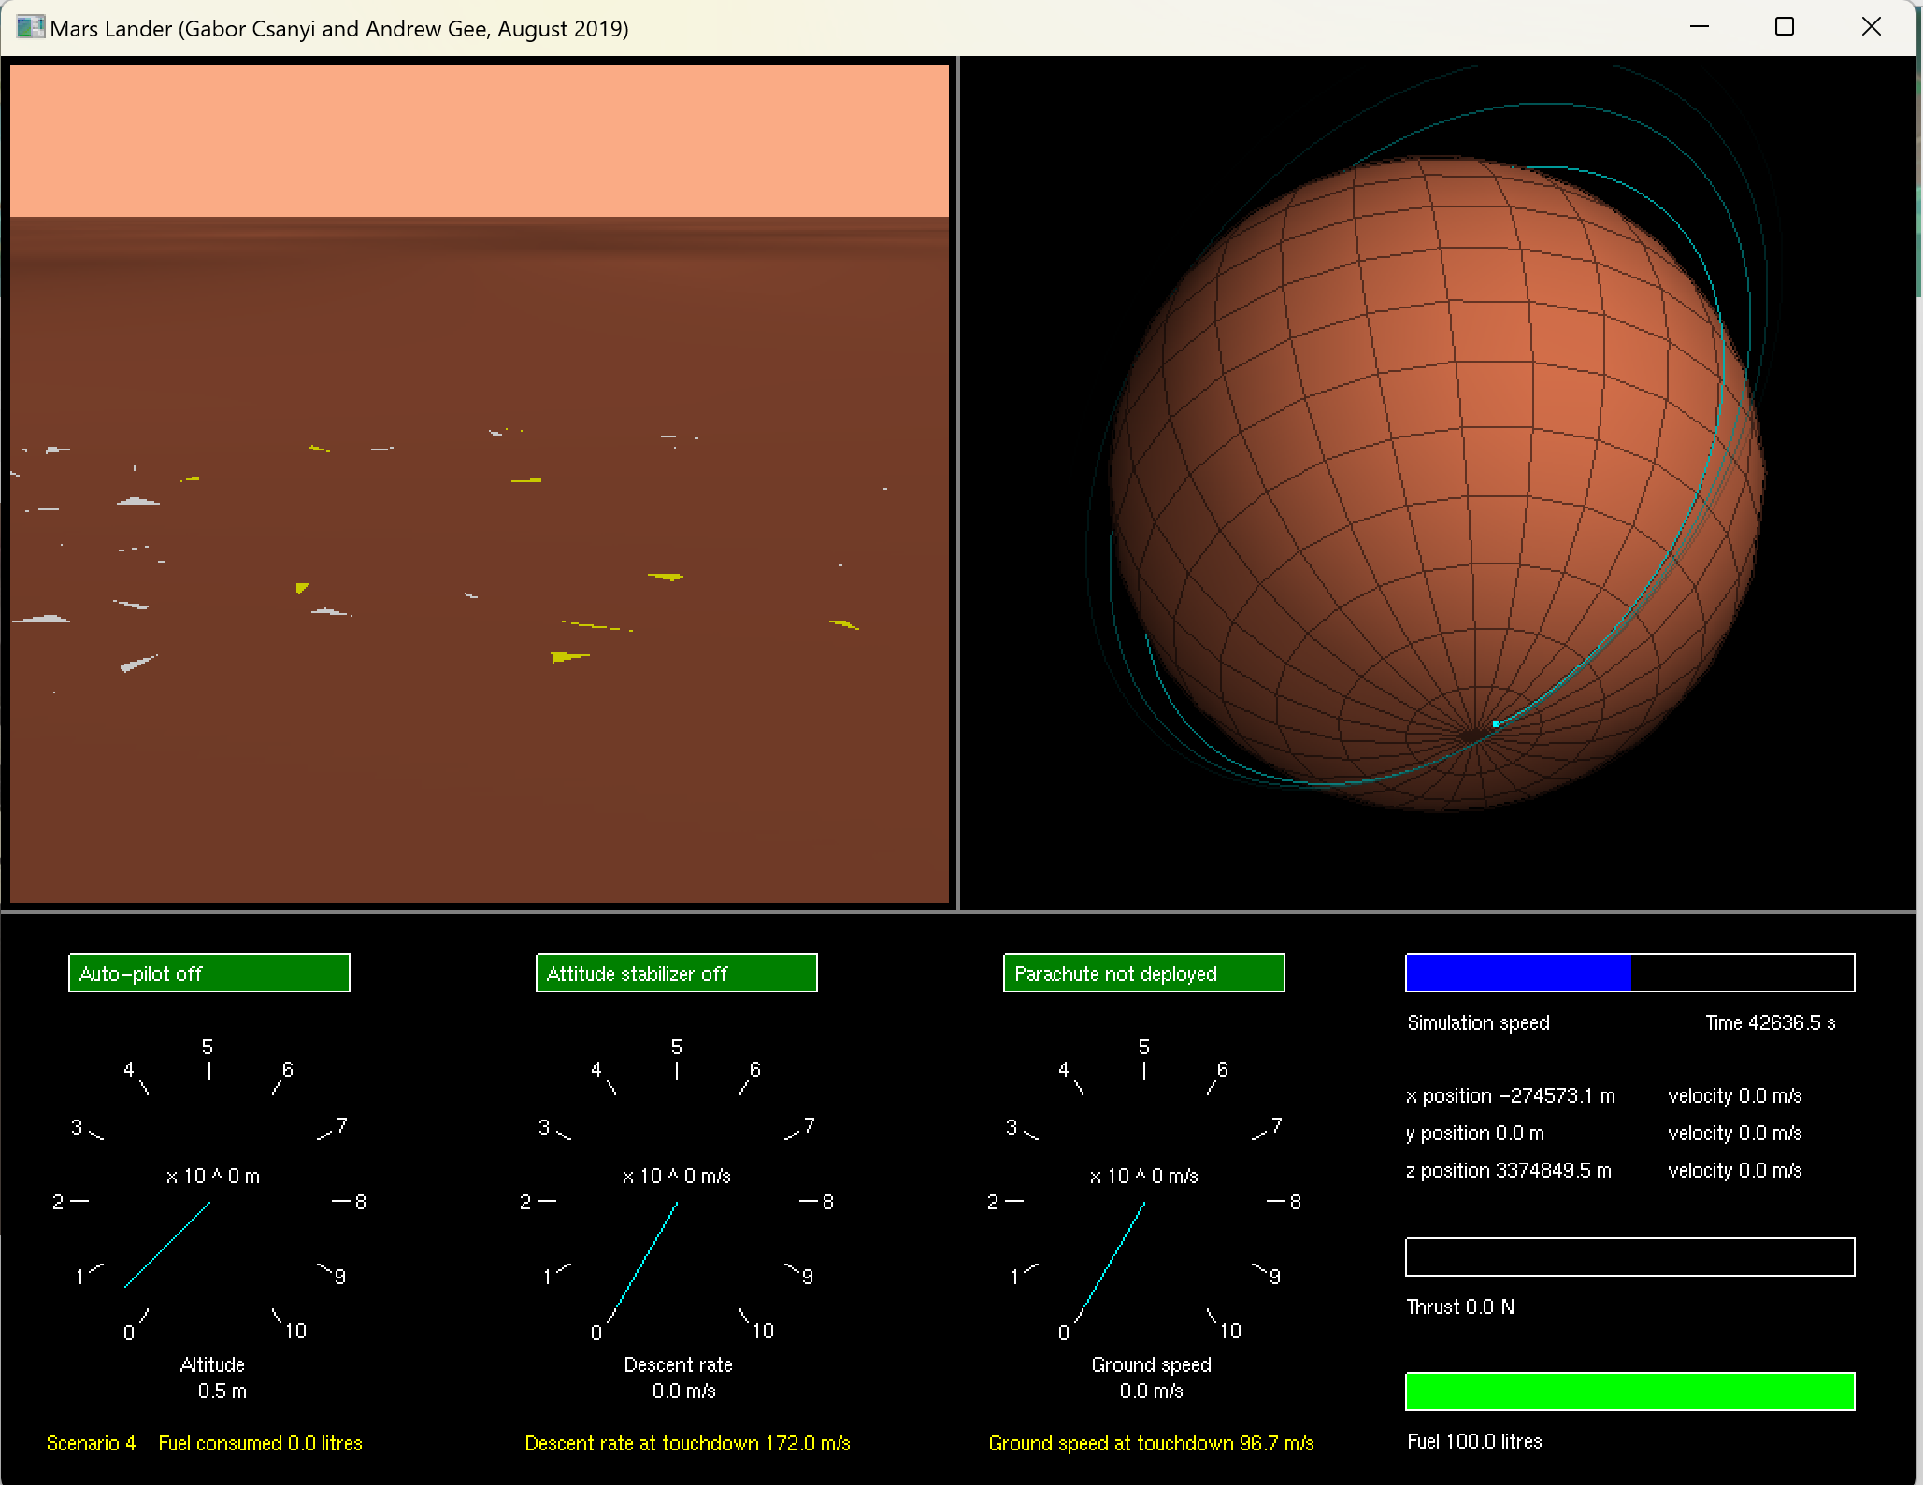

Scenario 4 fits the results given.

Slide 19
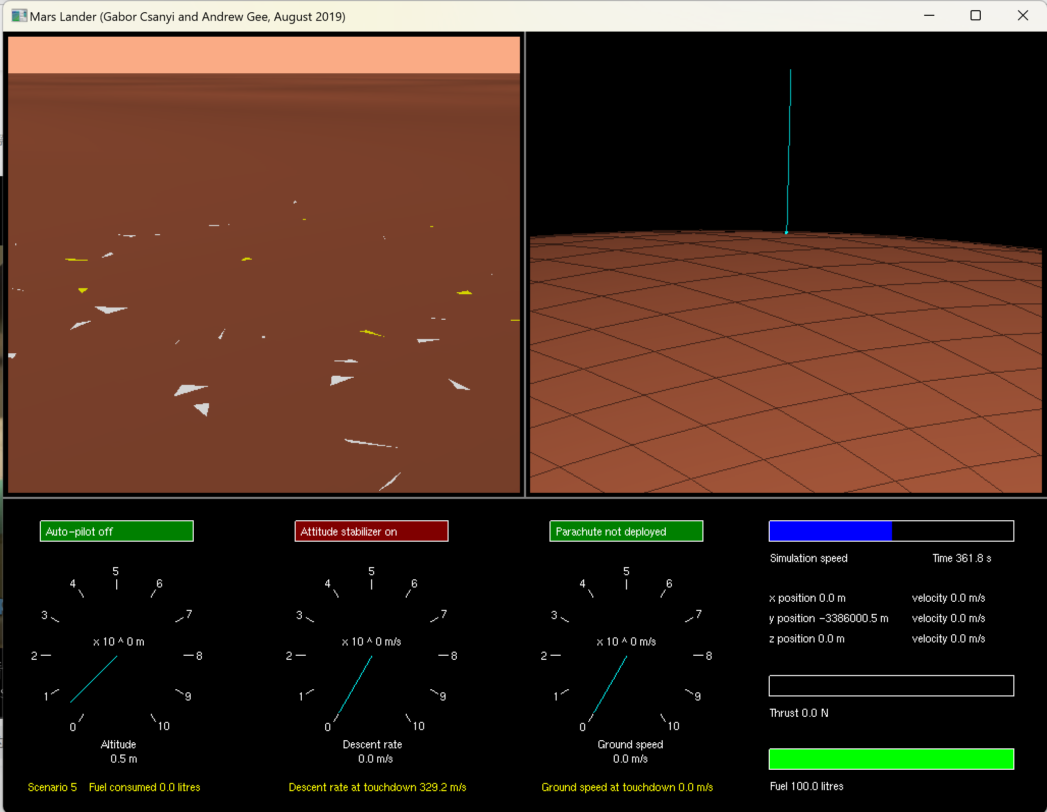

Scenario 5 is very close to the results given.

Slide 20
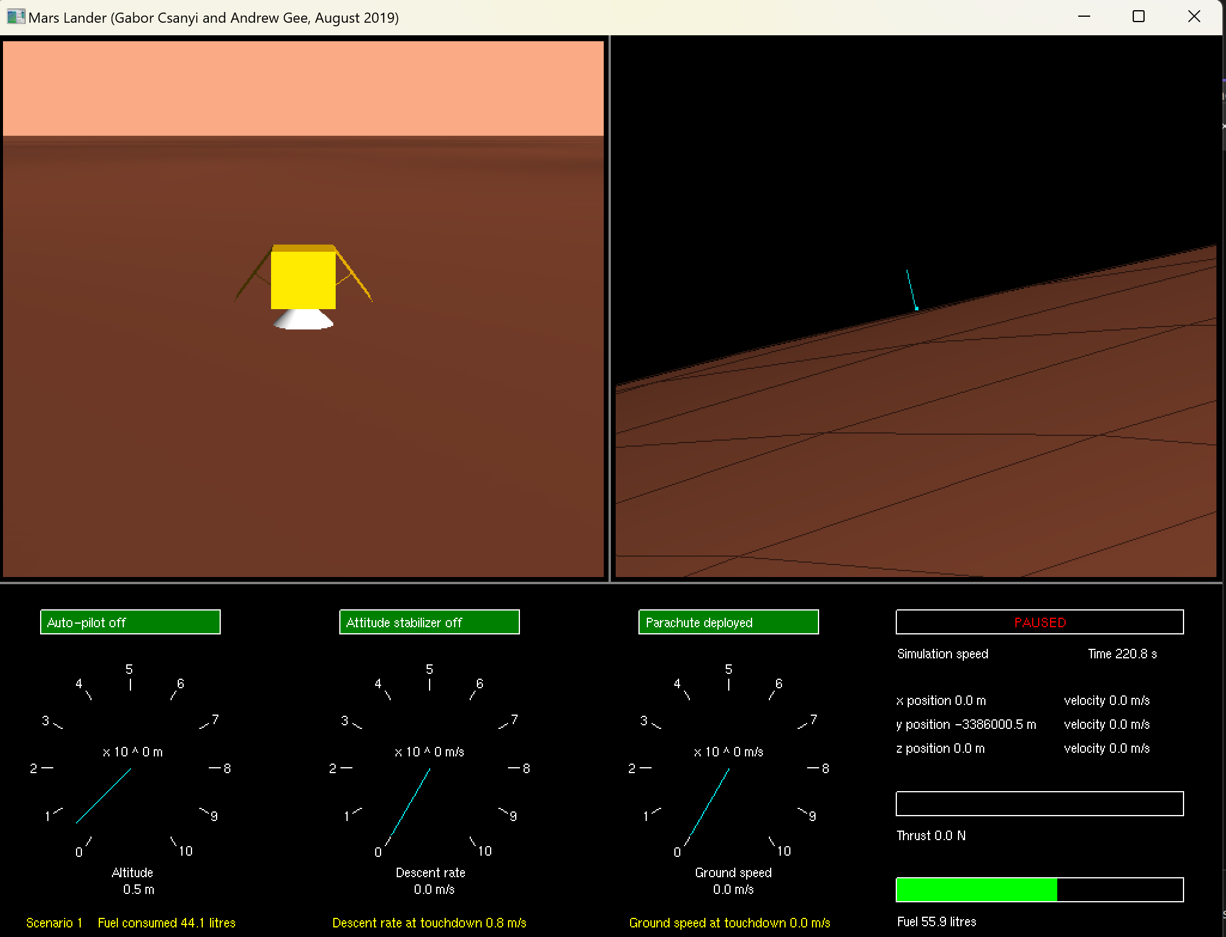
Successfully landed without breaking in scenario 1.

Slide 21
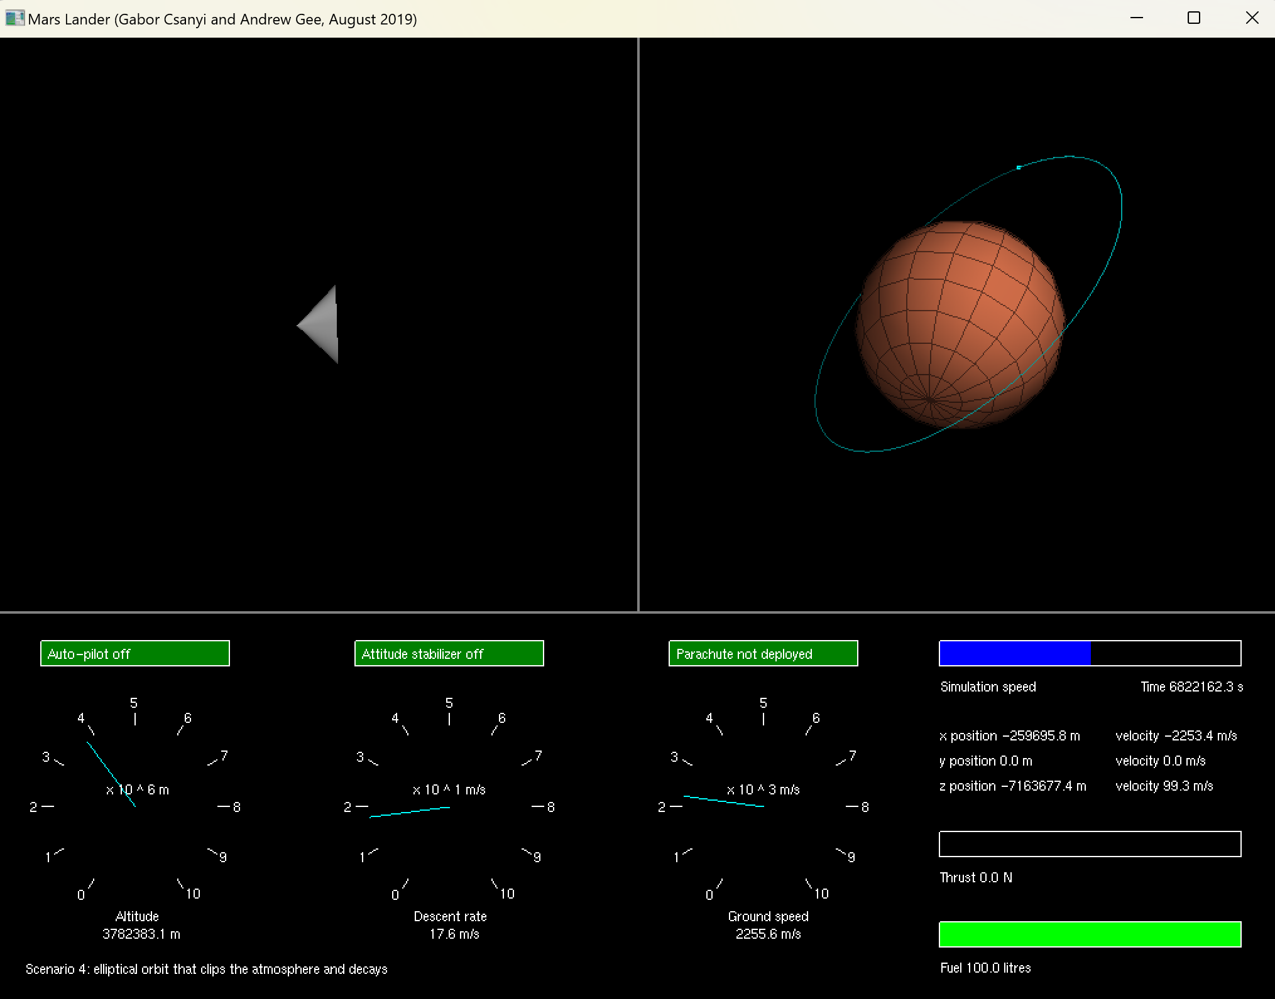

Comparison: scenario 4 using Euler integrator (img on right hand side) has no trend to stop, continues with ellipse trajectory, while with Verlet integrator it executed and land on surface in the end.
In conclusion, the Verlet integrator is more accurate in use and closer to reality.

Slide 22
Assignment 5: Autopilot
Implement the scheme of throttle given into the autopilot function and experiment with different constants. Resort to trial and error when tuning Kh and Kp. (set infinite fuel supply at first, but eventually should find suitable Kh that brings the lander down safely.) Understand the effect of Kh.
Adapt the program to output values of h and v.er at each time step. Read these values into Python and plot graphs using matplotlib of actual and target descent rate against altitude for various values of Kh.

Slide 23
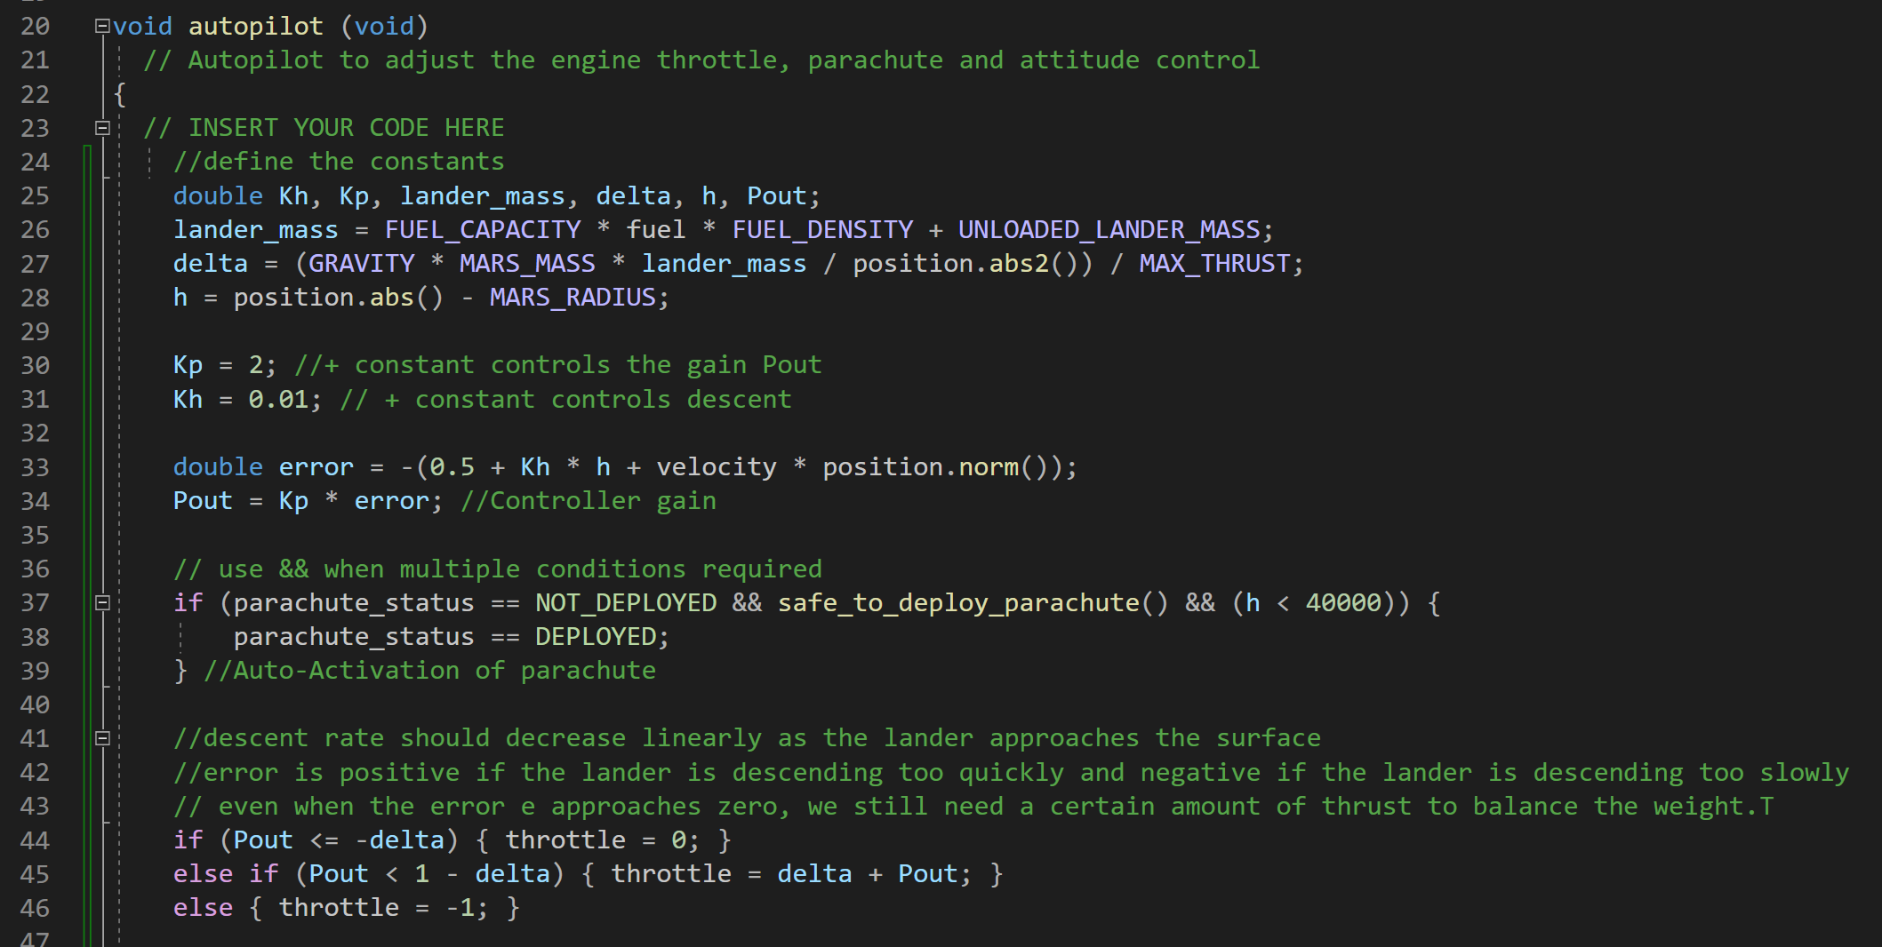
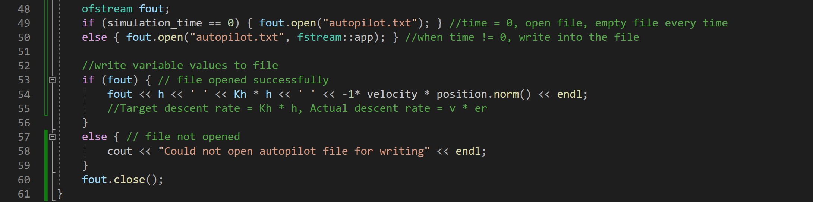
Code of Autopilot system and output of data

Slide 24
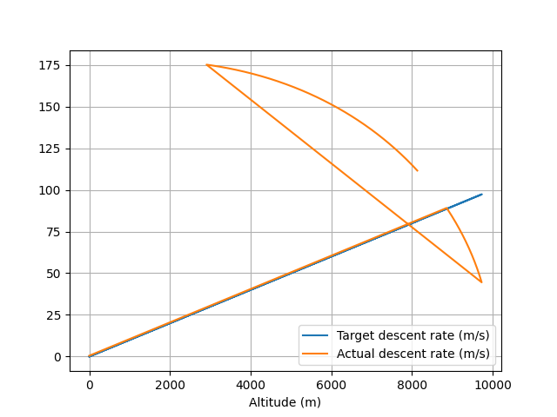
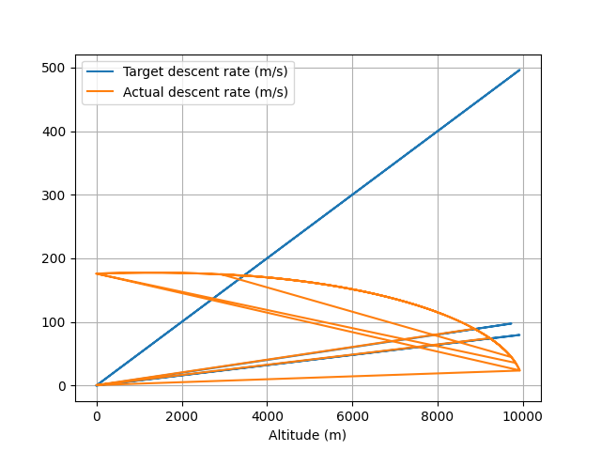
Plots of Target and Actual descent rates against altitude for different values of Kh
Kh=0.01
Kh=0.008

